Slide 1
Iris Image Classification Based on Hierarchical Visual Codebook
Group - 3
Name: Kazi Zunayed Quader Knobo
ID: 20241020
ST: Ehsanur Rahman Rhythm
RA: Md Sabbir Hossain

Slide 2
Introduction
Iris image classification aims to classify an iris image to an application specific category, e.g. iris liveness detection, race classification, coarse-to-fine iris detection, etc. .
Classification is done by the analysing the texture of the iris.
Iris biometrics need to find the similarity between different subjects, which classify iris images into several specific categories.

Slide 3
Problem and Challenges in Iris image classification
In classification, the class label corresponds to a group of subjects with similar properties of iris images (group identity). Iris texture naturally has unique pattern for each subject so we can extract the individually specific features to distinguish different subjects.
Difficult to classify images into predefined categories.
Iris image classification needs to find the stable relationship of similar iris texture features between different subjects.
How to define the common characteristics for each iris image category and the decision boundaries between different categories in the feature space?
How to represent iris image features suitable for the classification task?

Slide 4
Applications of Iris image Classification
Iris liveness detection is necessary to protect an iris recognition system from attacks of fake iris images.
Race classification: Automatic identification of the race attribute of a subject is desirable for many real world applications, such as intelligent marketing, services and forensics, etc.
Coarse-to-fine iris identification: Iris pattern is used to identify large population in many government and commercial applications. A possible solution to speed up large scale iris identification is to classify the large database into a number of categories based on iris texture. Then, a query iris image is the most promising to be identified using the templates from its corresponding category.

Slide 5
Hierarchical Visual Codebook
A novel texture representation method called Hierarchical Visual Codebook (HVC) is proposed to encode the texture primitives of iris images.
The HVC is an integration of two existing Bag-of-Words models, namely Vocabulary Tree (VT) and Locality-constrained Linear Coding (LLC).
It adopts coarse-to-fine visual coding strategy like VT and sparse representation of LLC.

Slide 6
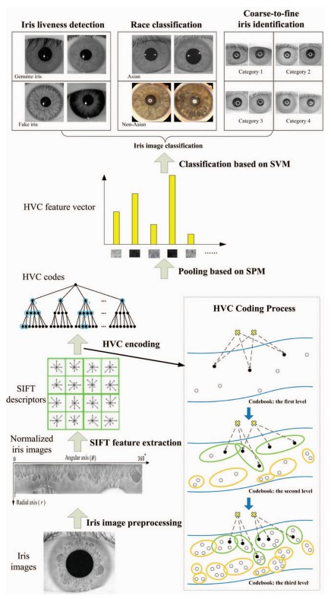
Flowchart of classifying iris image using HVC
1. Iris image preprocessing: segmentation of the valid iris texture regions from the original iris images and normalization of the ring-shape iris regions into a unified coordinate system
2. Low level feature extraction: obtain the common components of texture primitives across different iris images. So that it is possible to build a statistical representation on the basis of low level visual features for iris image classification
3. The proposed Hierarchical Visual Codebook: a novel visual feature representation method called Hierarchical Visual Codebook (HVC) is specially developed for iris image classification. The proposed HVC is inspired by two successful algorithms for visual pattern classification, namely Vocabulary Tree [27] and Locality-constrained Linear Coding (LLC)

Slide 7
Conclusion
Iris image classification aims to group iris images into multiple categories according to their application related attributes.
The core idea of iris image classification is to find common texture primitives of different subjects in the same category.
To integrate the advantages of both vocabulary tree and locality constrained linear coding, a novel iris feature representation method called Hierarchical Visual Codebook (HVC) is proposed to encode the distinctive and robust texture primitives of iris images.

